Slide 1
Forecasting Energy consumption
By: Irene Thomas

Slide 2
Agenda
Background
Objective
Initial Findings
Trend of the data
Forecasting
Conclusion

Slide 3
Background
Details of energy consumption of a house
47 months of energy utilization
Sub-metering 1 used for kitchen
Sub-metering 2 used for laundry room
Sub-metering 3 used for electric water heater and air condition
Global active power , global intensity and global reactive power measures provided
Initial analysis done using Tableau

Slide 4
Objective
To understand present trend of the data provided
Usage of different components in the house
Analyze energy consumption over the months
Forecast the energy consumption
Is there a possibility to reduce consumption

Slide 5
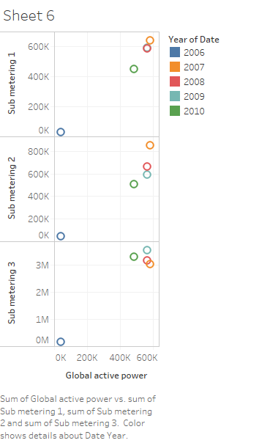
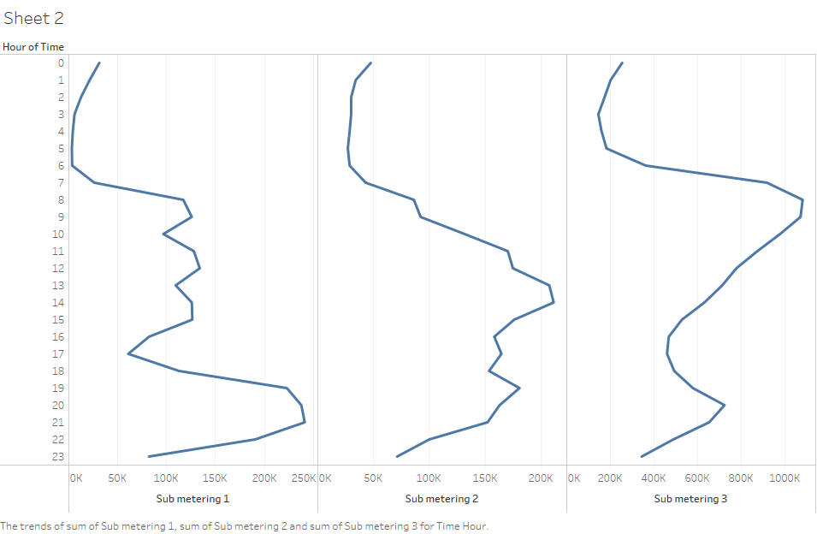
Initial Findings
Sub-metering is used for master-metered buildings
Highest consumption was in 2007
Correlation between Global active power and sub-metering

Slide 6
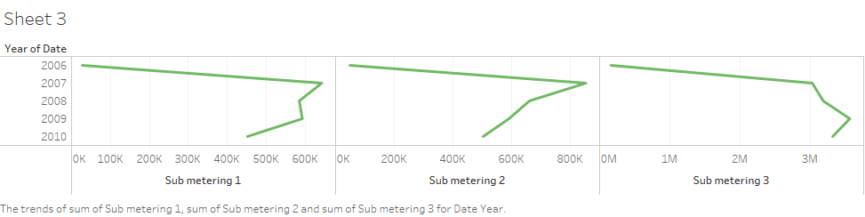
Trend of the data
Energy consumption starts to decrease from 2008
Chances of further decrease in the future
Sub-metering 1 and 2 show decreasing trend
Sub-metering 3 starts to decrease after 2009 but still has scope of reducing

Slide 7
Forecasting
Develop a model which will provide plausible information about the given data
Use time series analysis
Find the equipment's used and their timings
Analyze each factor to see when it increases or decreases
Find the relation between other provided information
Forecast for the next few months to see the trend

Slide 8
Conclusion
Data shows a clear view on how consumption has been over the years
Sub-meters and their patterns observed
Forecast using time series to see the pattern of the sub meters
Find possibilities of reducing the consumption and how using forecasting
Forecasting will help save money on energy bills
Lower maintenance cost and cost less to operate

